Slide 1

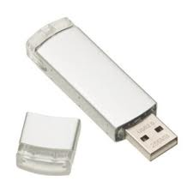
Your kids don’t need a USB!

Slide 2
Students can save work on the Student Portal. Here’s how.

Slide 3
1. Save your work onto the computer just the way that you normally do. (Use ‘My Documents’.)

Slide 4
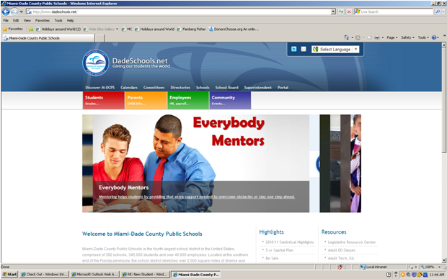
Go to dadeschools.net
Then click on
‘Students’

Slide 5
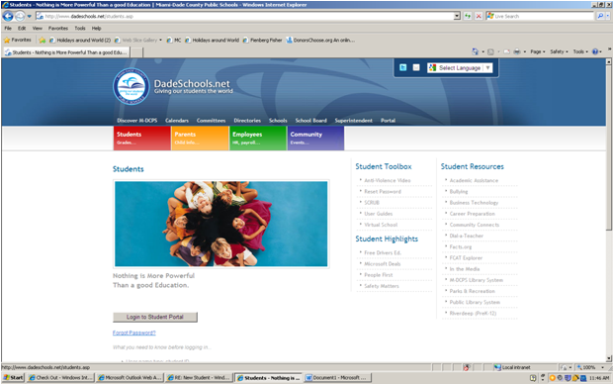

Log in to the portal

Slide 6
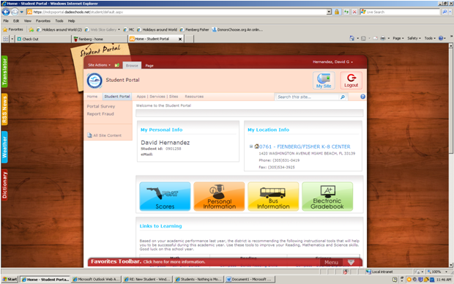

Click on ‘My Site’
Click on
‘My Site’

Slide 7
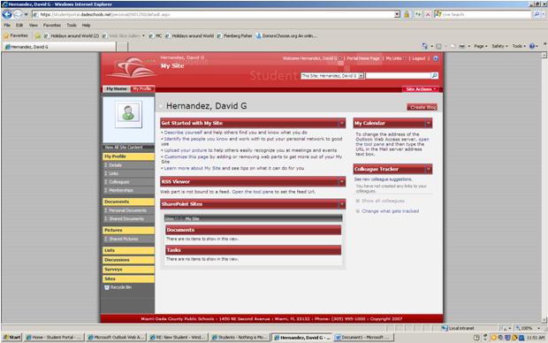
Click on ‘Personal Documents’

Slide 8
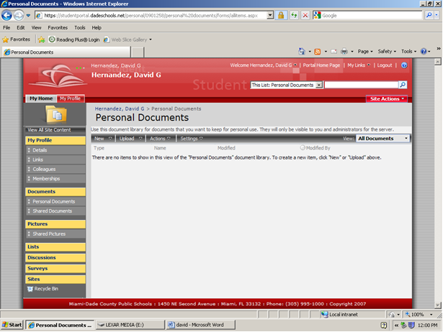
Upload your saved work onto ‘Personal Documents’.

Slide 9

Think of it!
No more lost / forgotten USBs.
Use the STUDENT PORTAL.

